Slide 1
Web scraping without programming Speakers: Robert Gebeloff – rgebeloff@nytimes.com Tom Johnson – tom@jtjohnson.com All materials: https://github.com/gebelo/nicar2016
NICAR Denver – March 2016
Notes:
The data's there. But it's trapped in an unfriendly format. In this session, we'll show you how to use free and easy tools to liberate information from various formats common to the Web ( HTML, PDF, JSON, XML) and get it into a format more ideal for data analysis.

Slide 2
Where we’re going…
Overall Process (TJ)
Productivity tips
All tools are good, but have limits.
Objective(s)
What kind of data? Where would it live?
File types? Containing what data types/formats?
What analytic tools for the data?
PDF extraction example
Demo Tools (RG)
Show how to get at underlying data, e.g. “Inspector” or “codebeautify”
Tips and Resources (Both)
Questions (Both)
NICAR Denver – March 2016

Slide 3
What the ????
Web scraping: “…the act of taking content from a website with the intent of using it for purposes outside the direct control of the site owner.”
Consider dual or LARGE monitors
NICAR Denver – March 2016
Notes:
Web scraping: “Web scraping is the act of taking content from a website with the intent of using it for purposes outside the direct control of the site owner.” [Source:Web Scraping : Everything You Wanted to Know (but were afraid to ask). JULY 22, 2015 by COURTNEY CLEAVES http://resources.distilnetworks.com/h/i/111901208-web-scraping-everything-you-wanted-to-know-but-were-afraid-to-ask/181642

Slide 4
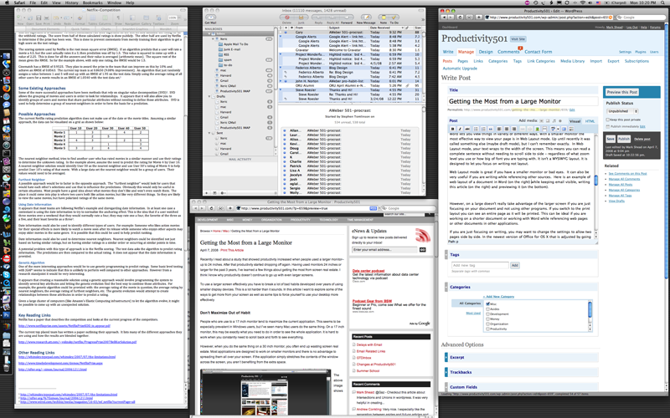

Large or Dual Monitors

Slide 5
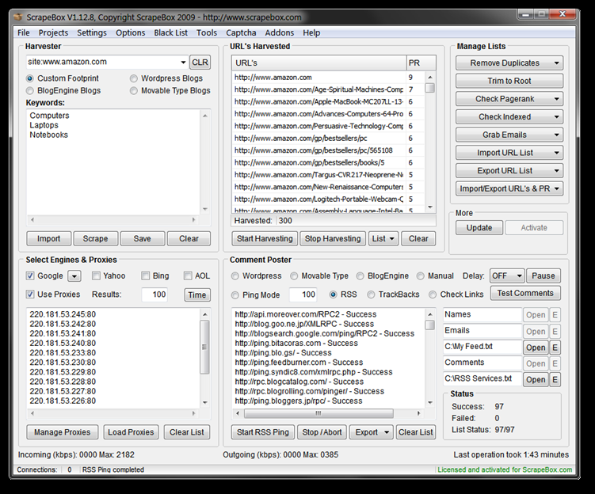
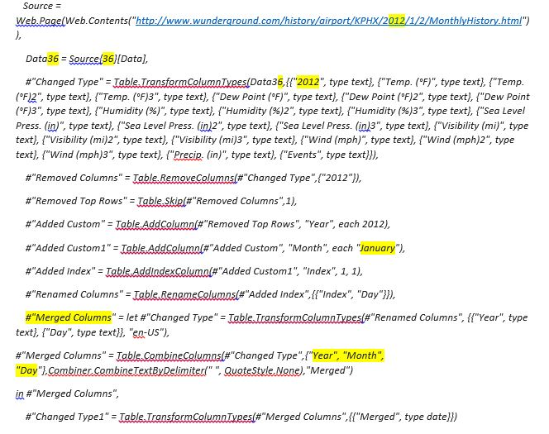
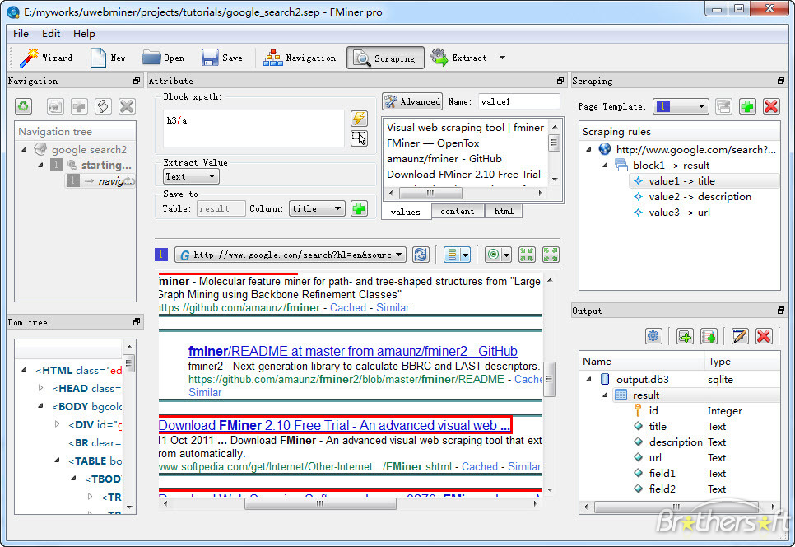
Dual Windows: Code and Results
Notes:
#1 –
#2 --
An alternative to multi-windows: ScrapeBox
#3 -- ScrapeBox -- http://www.garethjames.net/a-guide-to-web-scrapping-tools/

Slide 6
Process and tips…
NEVER work on downloaded, original files. Always a copy(ies)
Notes:
Simply put, version control is collaborative history tracking. This means if a group of people are working on a project — be it software or otherwise — they can use version control to track their progress and modifications without overwriting each other. - See more at: http://blog.flatironschool.com/lets-git-started-a-beginners-guide-to-version-control-software/#sthash.y9P3DLfJ.dpuf

Slide 7
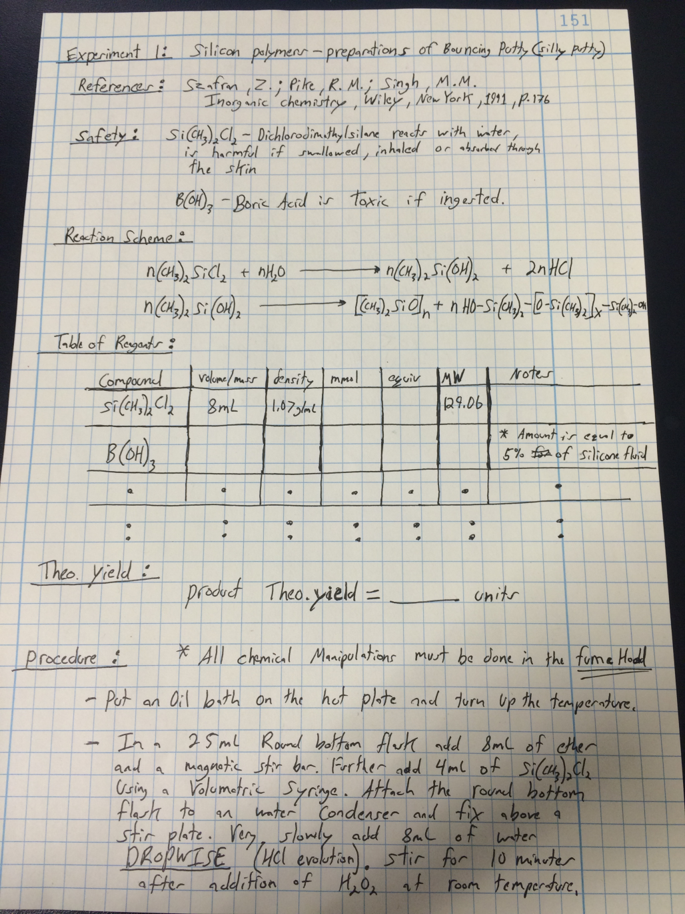
Maintain Lab book

Slide 8
Process and tips…
NEVER work on downloaded, original files. Always a copy(ies)
Consider version control …is collaborative history tracking..”
Vital if team effort
Comparison of version control software on Wikipedia
Notes:
Simply put, version control is collaborative history tracking. This means if a group of people are working on a project — be it software or otherwise — they can use version control to track their progress and modifications without overwriting each other. - See more at: http://blog.flatironschool.com/lets-git-started-a-beginners-guide-to-version-control-software/#sthash.y9P3DLfJ.dpuf

Slide 9
Process and tips…
NEVER work on downloaded, original files. Always a copy(ies)
Consider version control …is collaborative history tracking..”
Vital if team effort
Comparison of version control software on Wikipedia
Notes:
Simply put, version control is collaborative history tracking. This means if a group of people are working on a project — be it software or otherwise — they can use version control to track their progress and modifications without overwriting each other. - See more at: http://blog.flatironschool.com/lets-git-started-a-beginners-guide-to-version-control-software/#sthash.y9P3DLfJ.dpuf

Slide 10
5 TIPS FOR SCRAPING BIG WEBSITES
Cache pages visited for scraping
Don’t flood the website with large number of parallel requests , take it slow
Store the URLs that you have already fetched
Split scraping into different phases
Take only what’s required. Or not. [Big sites might have varied page structure.]
Source: Scrapehero: https://www.scrapehero.com/
NICAR Denver – March 2016
Notes:
1. Cache pages visited for scraping -- https://www.mnot.net/cache_docs/
When scraping big websites, its always a good idea to cache the data you have already downloaded. So you don’t have to put load on the website again, in case you have start over again or that page is required again during scraping. Its effortless to cache to a key value store like redis.B ut Databases and filesystem caches are also good. [Also: How to Cache a Website on Google - http://smallbusiness.chron.com/cache-website-google-46565.html
2. Don’t flood the website with large number of parallel requests , take it slow
Big websites posses algorithms to detect webscraping, large number of parallel requests from the same ip address will identify you as a Denial Of Service Attack on their website, and blacklist your IPs immediately. A better idea is to time your requests properly one after the other, giving it some human behavior. Oh!.. but scraping like that will take you ages. So balance requests using the average response time of the websites, and play around with the number of parallel requests to the website to get the right number.
3. Store the URLs that you have already fetched
You may want to keep a list of URLs you have already fetched, in a database or a key value store. What would you do if you scraper crashes after scraping 70% of the website. If you need to complete the remaining 30%, with out this list of URLs, you’ll waste a lot of time and bandwidth. Make sure you store this list of URLs somewhere permanent, till you have all the required data. This could also be combined with the cache. This way, you’ll be able to resume scraping.
4. Split scraping into different phases
Its easier and safer if you split the scraping into multiple smaller phases. For example, you could split scraping a huge site into two. One for gathering links to the pages from which you need to extract data and another for downloading these pages to scrape content.
5. Take only whats required
Don’t grab or follow every link unless its required. You can define a proper navigation scheme to make the scraper visit only the pages required. Its always tempting to grab everything, but its just a waste of bandwidth, time and storage.
Source: Web Scraping and Data Scraping: https://learn.scrapehero.com/5-tips-for-scraping-big-websites/ [3 March 2016]
Let’s Git Started: A Beginner’s Guide to Version Control Software - See more at: http://blog.flatironschool.com/lets-git-started-a-beginners-guide-to-version-control-software/#sthash.y9P3DLfJ.dpuf

Slide 11
HTML to Excel
You see a data table on the Web, but when you try to copy and paste it into Excel, you lose the formatting….

Slide 12
HTML to Excel
You see a data table on the Web, and want to get it into Excel….

Slide 13
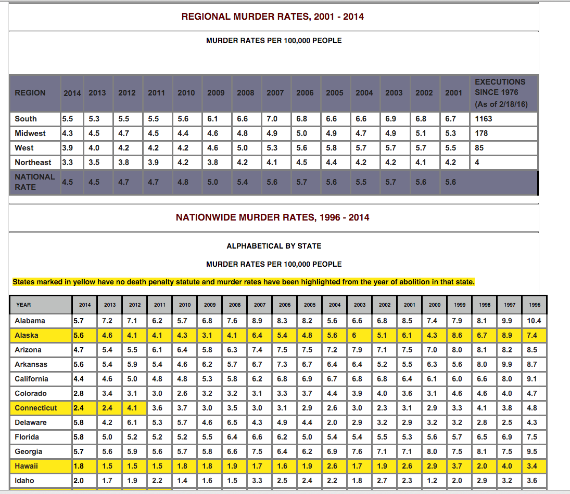
HTML to Excel

Slide 14
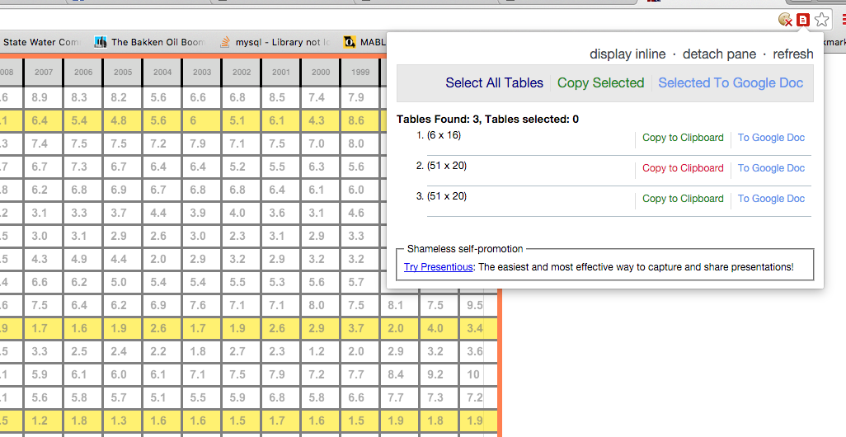
HTML to Excel
Chrome Table Capture:

Slide 15
HTML to Excel
Chrome Table Capture:

Slide 16
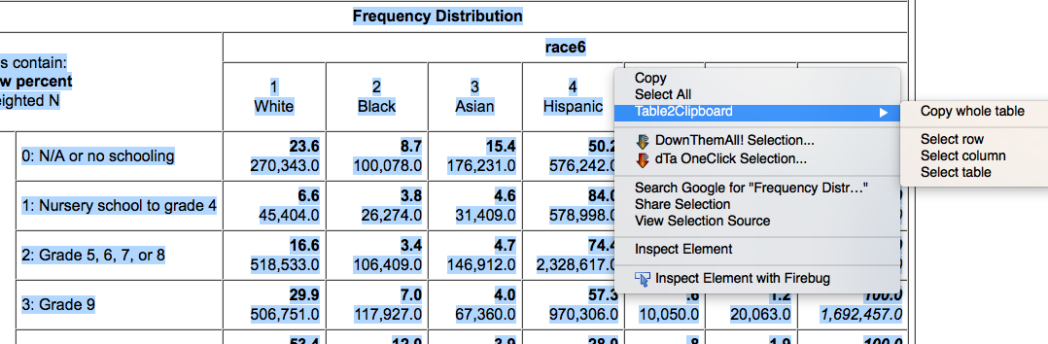
HTML to Excel
Also, Firefox Table2Clipboard:

Slide 17
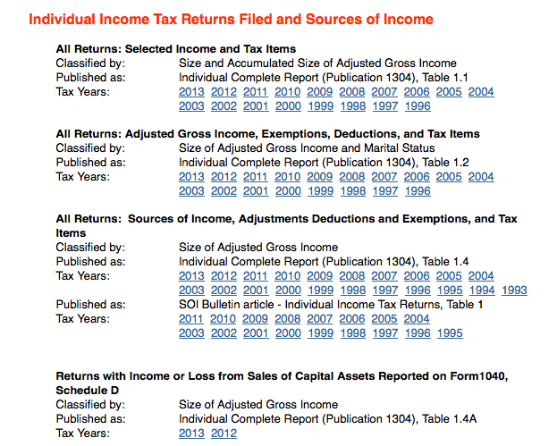
Down Them All!

Slide 18

Down Them All!
When you hover over links, you can see the file naming convention the page uses:
Table 1:
Table 2:
So we want all files that end with 11si.xls…

Slide 19
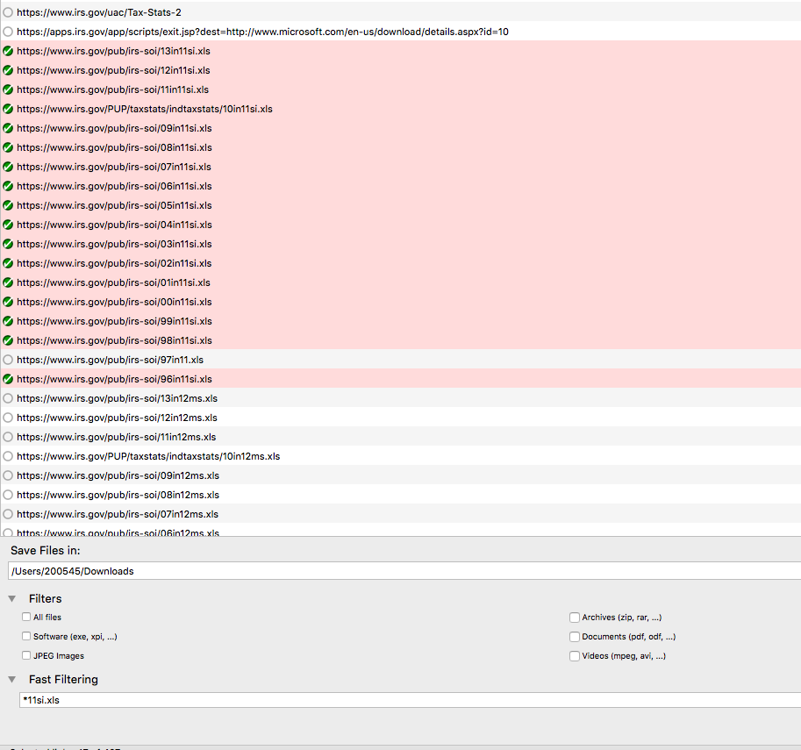
Down Them All!

Slide 20
CometDocs
One of many, and perhaps the easiest, way to deal with tables in PDFs. See my longer discussion…

Slide 21
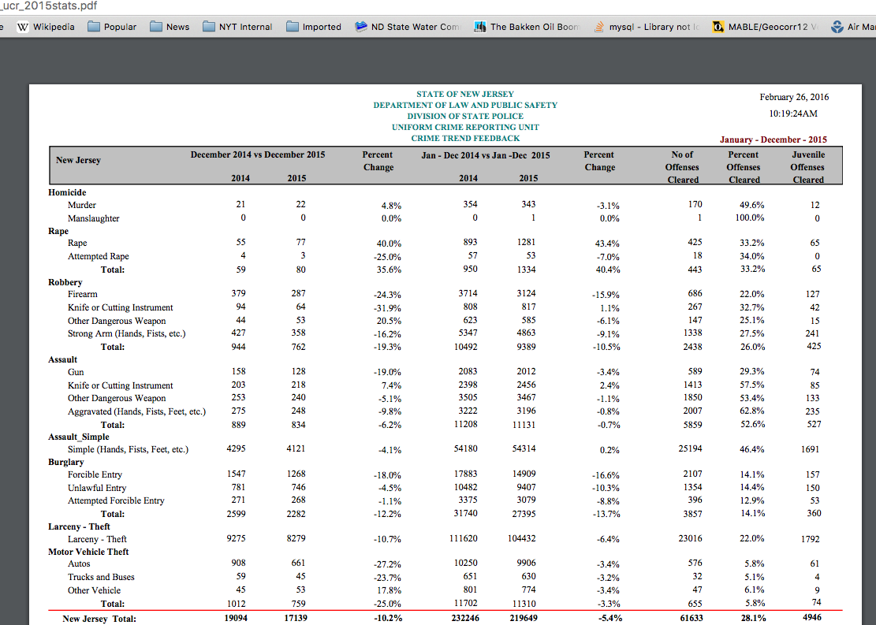

Slide 22
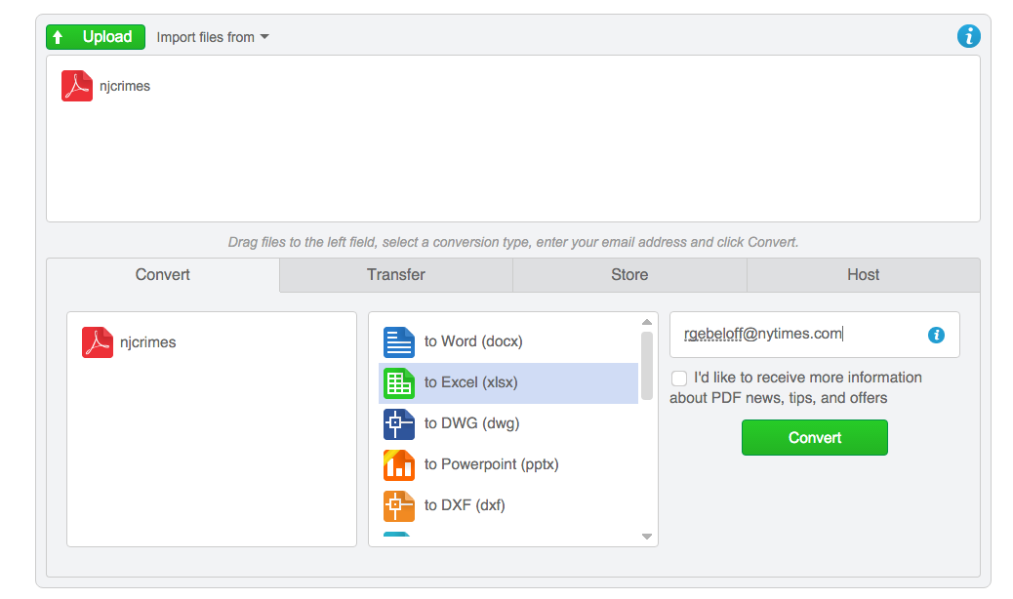

Slide 23
Import.IO
There’s no full substitute for being able to program your own scraper. But tools such as this can work well in many cases.
We’ll follow a tutorial I created…

Slide 24
Scraping w/o Programming
GRAND FINALE
Scrape data from a map!
Convert webby xml data to easier to deal with CSV!
Bonus: Convert some json too!
We’ll follow an example I created for a class I taught last year….
Notes:
https://github.com/sarahcnyt/data-journalism/blob/master/class4/xml_miracle.docx

Slide 25
Question time…
Thanks to…
Griff Palmer
Peter Verweij

Slide 26
Web scraping without programming Speakers: Robert Gebeloff – rgebeloff@nytimes.com Tom Johnson – tom@jtjohnson.com All materials: https://github.com/gebelo/nicar2016
NICAR Denver – March 2016
Notes:
The data's there. But it's trapped in an unfriendly format. In this session, we'll show you how to use free and easy tools to liberate information from various formats common to the Web ( HTML, PDF, JSON, XML) and get it into a format more ideal for data analysis.

